Slide 1
Digital Modulation Basics
EEE 367
Telecommunication Engineering

Slide 2
Modulation & Demodulation
Carrier
Radio
Channel
Carrier
Baseband
Modulation
Synchronization/Detection/
Decision
Data in
Data out

Slide 3
Modulation
Modulation - process (or result of the process) of translation the baseband message signal to bandpass (modulated carrier) signal at frequencies that are very high compared to the baseband frequencies.
Demodulation is the process of extracting the baseband message back the modulated carrier.
An information-bearing signal is non-deterministic, i.e. it changes in an unpredictable manner.

Slide 4
Why Carrier?
Effective radiation of EM waves requires antenna dimensions comparable with the wavelength:
Antenna for 3 kHz would be ~100 km long
Antenna for 3 GHz carrier is 10 cm long
Sharing the access to the telecommunication channel resources

Slide 5
Modulation Process
Modulation implies varying one or more characteristics (modulation parameters a₁, a₂, … a_{n}) of a carrier f in accordance with the information-bearing (modulating) baseband signal.
Sinusoidal waves, pulse train, square wave, etc. can be used as carriers

Slide 6
Continuous Carrier
Carrier: A sin[ωt +ϕ]
A = const
ω = const
ϕ = const
Amplitude modulation (AM)
A = A(t) – carries information
ω = const
ϕ = const
Frequency modulation (FM)
A = const
ω = ω(t)– carries information
ϕ = const
Phase modulation (PM)
A = const
ω = const
ϕ = ϕ(t) – carries information

Slide 7
Amplitude Shift Keying (ASK)
Baseband Data
1
0
0
1
0
ASK modulated
signal
Acos(ωt)
Acos(ωt)
Pulse shaping can be employed to remove spectral spreading
ASK demonstrates poor performance, as it is heavily affected by noise, fading, and interference

Slide 8
Frequency Shift Keying (FSK)
Baseband Data
1
0
0
1
BFSK modulated
signal
f₁
f₀
f₀
f₁
where f₀ =Acos(ω_{c}-Δω)t and f₁ =Acos(ω_{c}+Δω)t
Example: The ITU-T V.21 modem standard uses FSK
FSK can be expanded to a M-ary scheme, employing multiple frequencies as different states

Slide 9
Phase Shift Keying (PSK)
Baseband Data
1
0
0
1
BPSK modulated
signal
s₁
s₀
s₀
s₁
where s₀ =-Acos(ω_{c}t) and s₁ =Acos(ω_{c}t)
Major drawback – rapid amplitude change between symbols due to phase discontinuity, which requires infinite bandwidth. Binary Phase Shift Keying (BPSK) demonstrates better performance than ASK and BFSK
BPSK can be expanded to a M-ary scheme, employing multiple phases and amplitudes as different states

Slide 10
Demodulation & Detection
Demodulation
Is process of removing the carrier signal to obtain the original signal waveform
Detection – extracts the symbols from the waveform
Coherent detection
Non-coherent detection

Slide 11
Coherent Detection
An estimate of the channel phase and attenuation is recovered. It is then possible to reproduce the transmitted signal and demodulate.
Requires a replica carrier wave of the same frequency and phase at the receiver.
The received signal and replica carrier are cross-correlated using information contained in their amplitudes and phases.
Also known as synchronous detection

Slide 12
Coherent Detection 2
Carrier recovery methods include
Pilot Tone (such as Transparent Tone in Band)
Less power in the information bearing signal, High peak-to-mean power ratio
Carrier recovery from the information signal
E.g. Costas loop
Applicable to
Phase Shift Keying (PSK)
Frequency Shift Keying (FSK)
Amplitude Shift Keying (ASK)

Slide 13
Non-Coherent Detection
Requires no reference wave; does not exploit phase reference information (envelope detection)
Differential Phase Shift Keying (DPSK)
Frequency Shift Keying (FSK)
Amplitude Shift Keying (ASK)
Non coherent detection is less complex than coherent detection (easier to implement), but has worse performance.

Slide 14
Amplitude Shift Keying
The general expression for a binary ASK signal is
v(t) = A m(t)cosω_{c}t 0<=t<=T
where
v(t)= binary ASK waveform
A = peak unmodulated carrier amplitude
ω_{c} = radian carrier frequency
T = bit duration

Slide 15
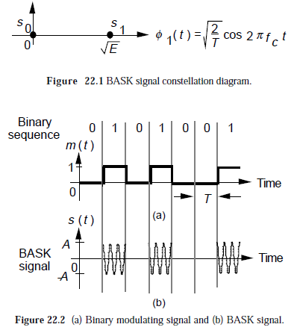
Amplitude Shift Keying
the signal space or constellation diagram of the BASK signals is shown in Figure 22.1.
Figure 22.2 shows the BASK signal sequence generated by the binary sequence 0 1 0 1 0 0 1.
The amplitude of a carrier is switched or keyed by the binary signal m(t).
This is sometimes called on-off keying (OOK).

Slide 16
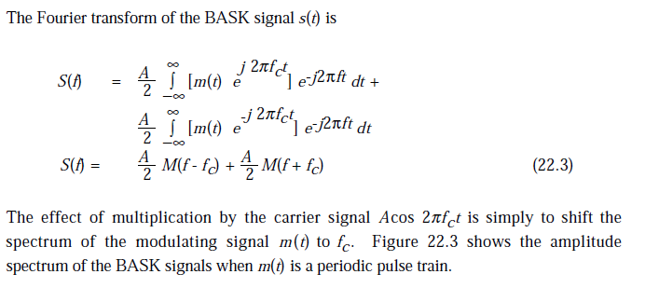
Amplitude Shift Keying

Slide 17
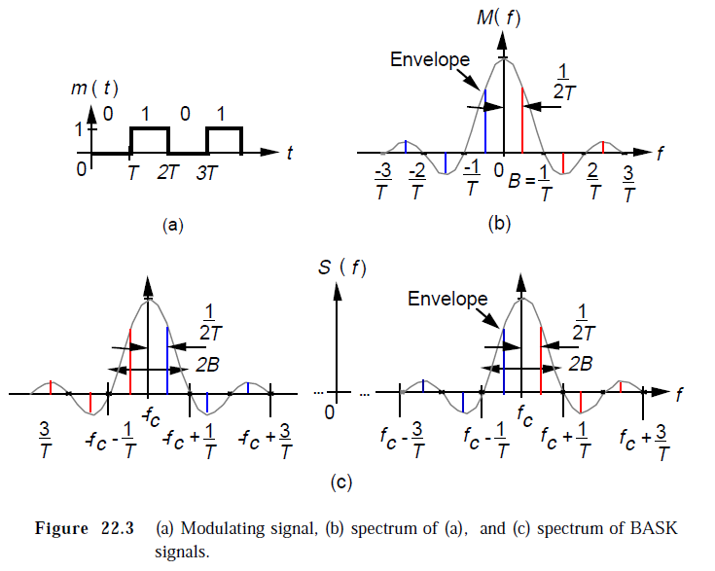
Amplitude Shift Keying

Slide 18
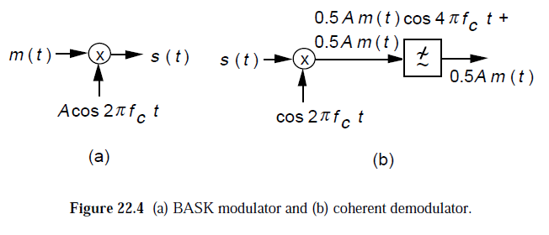
Amplitude Shift Keying
Since we define the bandwidth as the range occupied by the baseband signal m(t) from 0 Hz to the first zero-crossing point, we have B Hz of bandwidth for the baseband signal and 2B Hz for the BASK signal.
Figure 22.4 shows the modulator and a possible implementation of the coherent demodulator for BASK signals.

Slide 19
Frequency Shift Keying
The general expression for a binary FSK signal is
v(t) = V_{c}cos{[ω_{c} + (½ f_{m}(t)Δω)]t} (13-3)
where
v(t)= binary FSK waveform
V_{c} = peak unmodulated carrier amplitude
ω_{c} = radian carrier frequency
f_{m}(t) = binary digital modulating signal frequency
Δω = radian difference in output frequency

Slide 20
Frequency Shift Keying
From Equ. (13-3) it is seen that with binary FSK the carrier amplitude V_{c} remains constant with modulation. However, the output carrier radian frequency (ω_{c}) shifts by an amount equal to +Δω/2.
The frequency shift Δω/2 is proportional to the amplitude and polarity of the binary input signal. For example, a binary ‘1’ could be +1 volt and a binary ‘0’ could be –1 volt producing frequency shifts of +Δω/2 and -Δω/2, respectively.
The rate the carrier frequency shifts is equal to the input bit rate f_{m}(t) the binary signal deviates between ω_{c}+Δω/2 and ω_{c}-Δω/2. Thus the output carrier frequency deviates between ω_{c}+Δω/2 and ω_{c}-Δω/2 at a rate equal to f_{m}(t).

Slide 21
FSK Transmitter
With binary FSK, the center carrier frequency is shifted (deviated) by the binary input data. As the binary input signal changes from a logic ‘0’ to a logic ‘1’, and vice versa, the FSK output shifts between mark (or logic ‘1’) frequency and space (or logic ‘0’) frequency.
The rate of change at the modulator input is called the bit rate and has the units of bits per second (bps). The rate of change at the modulator output is called the baud rate and is equal to the reciprocal of the time of one output signaling element.
In binary FSK, the input and output rates of change are equal; therefore, the bit rate and baud rate are equal. A simple binary FSK transmitter is shown in Figure 13-3.

Slide 22
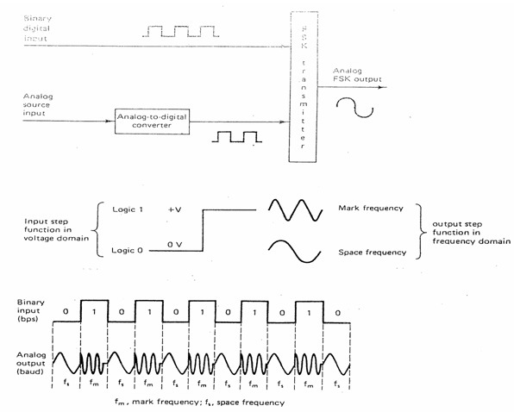
FSK Transmitter
Fig. 13-3. Binary FSK transmitter.

Slide 23
Bandwidth Considerations of FSK
Figure 13-4 shows a binary FSK modulator. The fastest input rate of change occurs when the binary input is a series of alternating 1’s and 0’s.
Consequently, if only the fundamental frequency of the input is considered, the highest modulating frequency is equal to one-half of the input bit rate.
A logic ‘1’ input shifts the VCO from its rest frequency to the mark frequency, and a logic ‘0’ input shifts the VCO from its rest frequency to the space frequency.

Slide 24
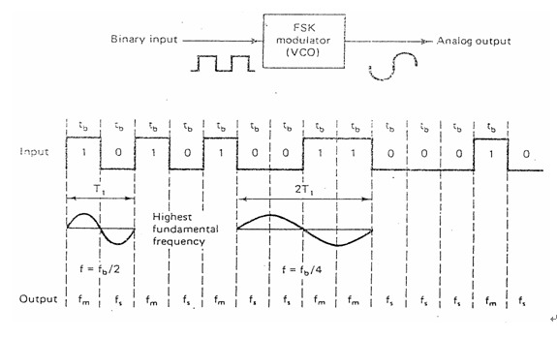
Bandwidth Considerations of FSK
Fig. 13-4. FSK modulator.

Slide 25
Bandwidth Considerations of FSK
Consequently, as the input binary signal changes from a logic ‘1’ to a logic ‘0’, and vice versa, the VCO output frequency shifts or deviates back and forth between the mark and space frequencies.
For binary FSK, modulation index is given as
m_{f} = Δf / f_{a}
= |(f_{m}-f_{s})/2|/(f_{b}/2)
= |f_{m} - f_{s}|/f_{b} (13-4)
where m_{f} = modulation index
Δf = frequency deviation (Hz)
f_{a} = modulating frequency (Hz)

Slide 26
Bandwidth Considerations of FSK
Example 13-1:
For a binary FSK modulator with space, rest, and mark frequencies of 60, 70, and 80 MHz, respectively and an input bit rate of 20 Mbps, determine the output baud and the minimum required bandwidth.
Solution:
Substituting into Equ. (13-4), we have
m_{f} = |(f_{m} – f_{s})/f_{b}|
= |80MHz–60MHz|/20Mbps
= 20MHz/20Mbps
= 1.0

Slide 27
Bandwidth Considerations of FSK
From the Bessel chart (Table 13-1), a modulation index of 1.0 yields three sets of significant side frequencies. Each side frequency is separated from the center frequency or adjacent side frequency by the modulating frequency, which is 10 MHz (f_{b}/2) in this example.
The output spectrum for this modulator is shown in Figure 13-5. It can be seen that the minimum double-sided Nyquist bandwidth is 60 MHz and the baud rate is 20 megabaud, the same as the bit rate.

Slide 28
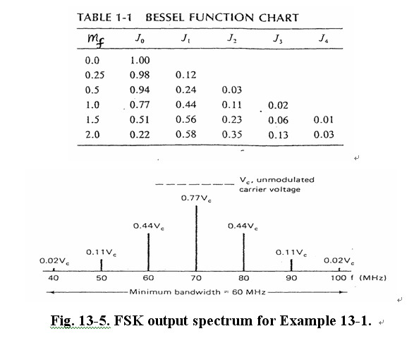
Bandwidth Considerations of FSK

Slide 29
FSK Receiver
The most common circuit used for demodulating binary FSK signals is the phase-locked loop (PLL), which is shown in block diagram form in Figure 13-6.
As the input to the PLL shifts between the mark and space frequencies, the dc error voltage at the output of the phase comparator follows the frequency shift.
The natural frequency of the PLL is generally made equal to the center frequency of the FSK modulator.
The changes in the dc error voltage will then follow
the changes in the analog input frequency and are symmetrical around 0 Vdc.

Slide 30
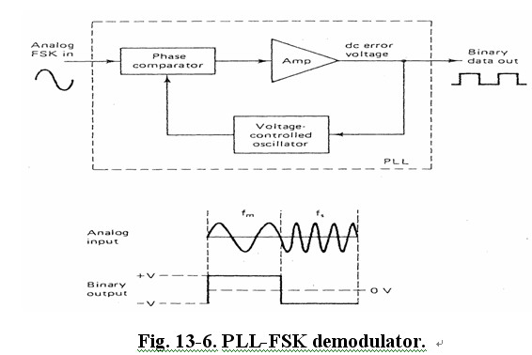
FSK Receiver

Slide 31
FSK Receiver
Binary FSK has a poorer error performance than PSK or QAM and, consequently, is seldom used for high-performance digital radio systems.
Its use is restricted to low-performance, low-cost, asynchronous data modems that are used for data communications over analog, voice band telephone lines.

Slide 32
Minimum Shift-Keying
Minimum shift-keying (MSK) is a form of continuous-phase FSK (CPFSK). Essentially, MSK is a binary FSK except that the mark and space frequencies are synchronized with the input binary bit rate.
With MSK, the mark and space frequencies are selected such that they are separated from the center frequency by an exact odd multiple of one-half of the bit rate.
This ensures that there is a smooth phase transition in the analog output signal when it changes from a mark to a space frequency, or vice versa.

Slide 33
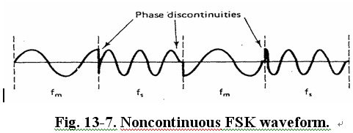
Minimum Shift-Keying

Slide 34
Minimum Shift-Keying
Figure 13-7 shows a noncontinuous FSK waveform. When the input changes from a logic ‘1’ to a logic ‘0’, and vice versa, there is an abrupt phase discontinuity in the analog output signal.
When this occurs, the demodulator has trouble following the frequency shift; consequently, an error may occur. Figure 13-8 shows a continuous phase MSK waveform.
MSK has a better bit-error performance than conventional binary FSK for a given SNR. The disadvantage of MSK is that it requires synchronizing circuits and it therefore more expensive to implement.

Slide 35
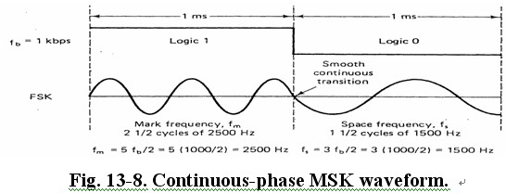
Minimum Shift-Keying

Slide 36
Binary Phase Shift Keying
With binary phase shift keying (BPSK), two output phases are possible for a single carrier frequency.
One output phase represents a logic ‘1’ and the other
a logic ‘0’.
As the input digital signal changes state, the phase of the output carrier shifts between two angles that are 180° out of phase. BPSK is a form of suppressed carrier, square-wave modulation of a continuous wave (CW) signal.

Slide 37
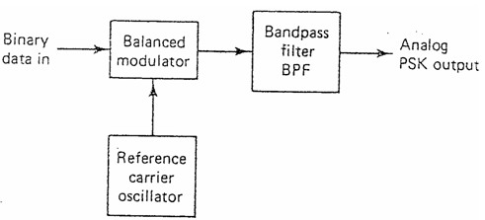
Binary Phase Shift Keying
BPSK Transmitter
Figure 13-9 shows a simplified block diagram of a BPSK modulator. The balanced modulator acts like a phase reversing switch.
Fig. 13-9. BPSK modulator.

Slide 38
Binary Phase Shift Keying
In BPSK, depending on the logic condition of the digital input, the carrier is transferred to the output either in phase or 180° out of phase with the reference carrier oscillator.
Figure 13-10a shows the schematic diagram of a balanced ring modulator.
If the binary input is a logic ‘1’ (positive voltage), diodes D1 and D2 are forward biased and “on”, while diodes D3 and D4 are reverse biased and “off” (Figure 13-10b).
The carrier voltage developed across transformer T2 is in phase with the carrier voltage across T1. Consequently, the output signal is in phase with the reference oscillator.

Slide 39
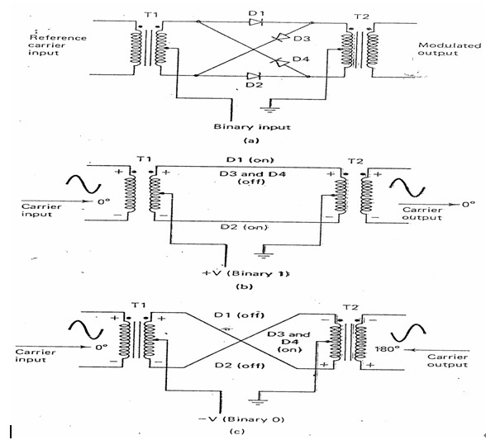
Binary Phase Shift Keying
Fig. 13-10. (a) Balanced ring modulator;
(b) Logic ‘1’ input; (c) Logic ‘0’ input.

Slide 40
Binary Phase Shift Keying
If the binary input is a logic ‘0’ (negative voltage), diodes D1 and D2 are reverse biased and “off,” while diodes D3 and D4 are forward biased and “on” (Figure 13-10c).
The carrier voltage developed across transformer T2
is 180°out of phase with the carrier voltage across T1. Consequently, the output signal is 180° out of phase with the reference oscillator.
Figure 13-11 shows the truth table, phasor diagram, and constellation diagram for a BPSK modulator.
A constellation diagram, or signal state-space diagram, is similar to a phasor diagram except that the entire phasor is not drawn. In a constellation diagram, only the relative positions of the peaks of the phasors are shown.

Slide 41
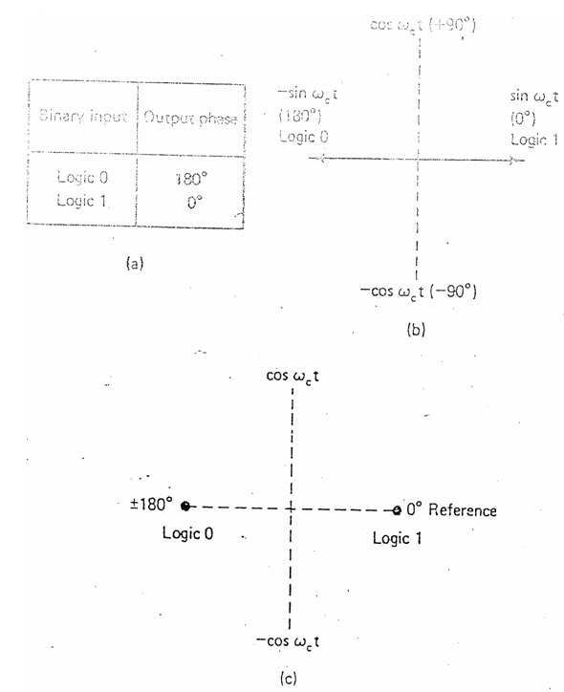
Binary Phase Shift Keying
Fig. 13-11. BPSK modulator: (a) truth table;
(b) phasor diagram; (c) constellation diagram.

Slide 42
Bandwidth Considerations of BPSK
For BPSK, the output rate of change (baud) is equal to the input rate of change (bps), and the widest output bandwidth occurs when the input binary data are an alternating 1/0 sequence.
The fundamental frequency (f_{a}) of an alternating 1/0 bit sequence is equal to one-half of the bit rate (f_{b}/2).
Mathematically, the output phase a BPSK modulator is
output = (sinω_{a}t) x (sinω_{c}t) = (1/2)cos(ω_{c}-ω_{a})t – (1/2)cos(ω_{c}+ω_{a})t (13-6)
Consequently, the minimum double-sided Nyquist bandwidth (f_{N}) is f_{N} = 2 x (f_{b}/2) = f_{b} .

Slide 43
Bandwidth Considerations of BPSK
Figure 13-12 shows the output phase versus time relationship for a BPSK waveform.
The output spectrum from a BPSK modulator is simply
a double-sideband suppressed carrier signal where the upper and lower side frequencies are separated from the carrier frequency by one-half of the bit rate.
Consequently, the minimum bandwidth (f_{N}) required to pass the worst-case BPSK output signal is equal to input bit rate.

Slide 44
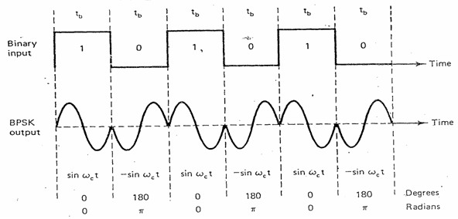
Bandwidth Considerations of BPSK
Fig. 13-12. Output phase vs. time for a BPSK modulator.

Slide 45
Bandwidth Considerations of BPSK
Example 13-2: For a BPSK modulator with a carrier frequency of 70 MHz and an input bit rate on 10 Mbps, determine the maximum and minimum upper and lower side frequencies, draw the output spectrum, determine the minimum Nyquist bandwidth, and calculated the baud.
Solution:
Substituting into Equ. (13-6) yields
Output = (sinω_{a}t)(sinω_{c}t)

Slide 46
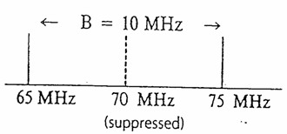
Bandwidth Considerations of BPSK
Minimum lower side frequency (LSF):
LSF = 70 MHz-5 MHz = 65 MHz
Maximum upper side frequency (USF):
USF = 70 MHz+5 MHz = 75 MHz
The minimum Nyquist bandwidth (f_{N}) for
the worst-case binary input conditions is
f_{N} = 75 MHz – 65 MHz = 10 MHz
and the baud rate is f_{b} = 10 megabaud.

Slide 47
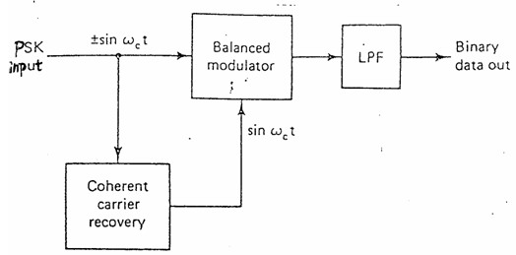
BPSK Receiver
Fig. 13-13. BPSK receiver.

Slide 48
BPSK Receiver
For BPSK input signal of +sinω_{c}t (logic ‘1’), the output of the balanced modulator is (sinω_{c}t)(sinω_{c}t) = sin²ω_{c}t ,
or sin²ω_{c}t = ½(1-cos2ω_{c}t) = ½ - ½ cos2ω_{c}t.
After LPF, the term of cos2ω_{c}t will be filtered out, leaving Output = +1/2 Vdc = logic ‘1’
For BPSK input signal of -sinω_{c}t (logic ‘0’), the output of the balanced modulator is -(sinω_{c}t)(sinω_{c}t) = -sin²ω_{c}t ,
or -sin²ω_{c}t = -½(1-cos2ω_{c}t) = -½ + ½ cos2ω_{c}t.
After LPF, the term of cos2ω_{c}t will be filtered out, leaving Output = -1/2 Vdc = logic ‘0’

